Slide 1
Neuron / Perceptron
&
Neural Network

Slide 2
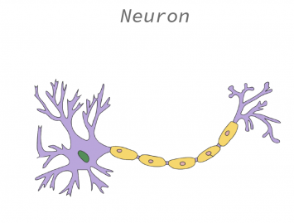
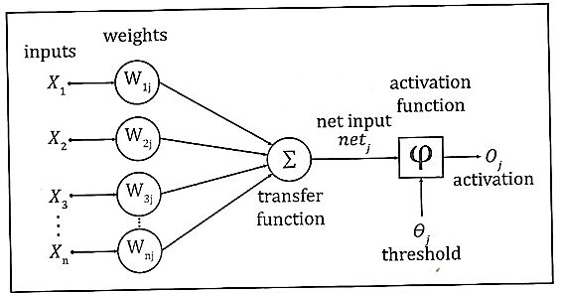
Perceptron
Perceptron provides output Yp and original output for datapoint X is Y.
If Yp is different from Y then we need to update the values of weights.
The rule is,

Slide 3
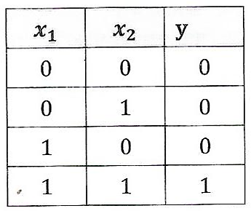
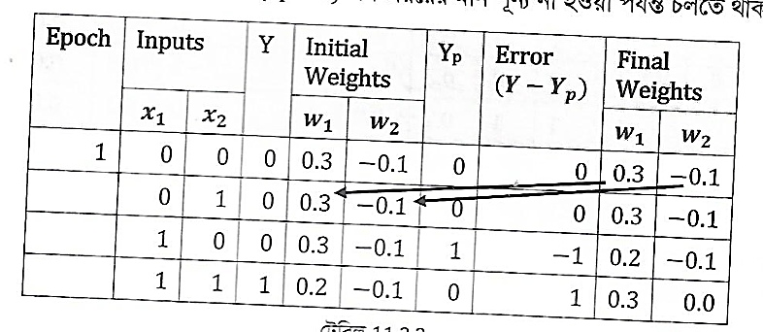
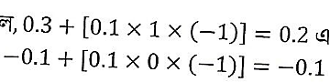
Training the Perceptron
Lets assume,
Primary weights are 0.3 and -0.1. You can assume any other value including 0.
Learning Rate = 0.1
Threshold Value = 0.2
Error = -1 for (1, 0) input.
Reason for output 1,
Updated Weights are

Slide 4
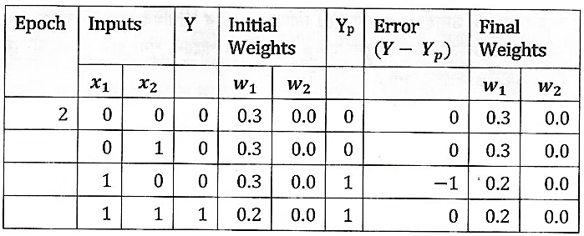
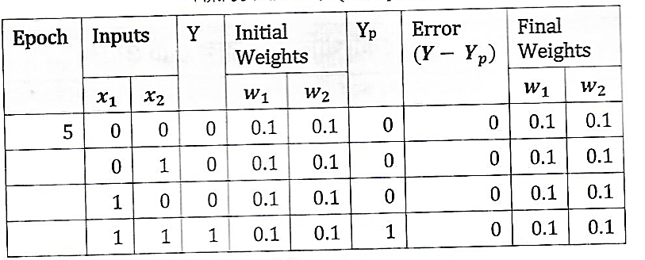
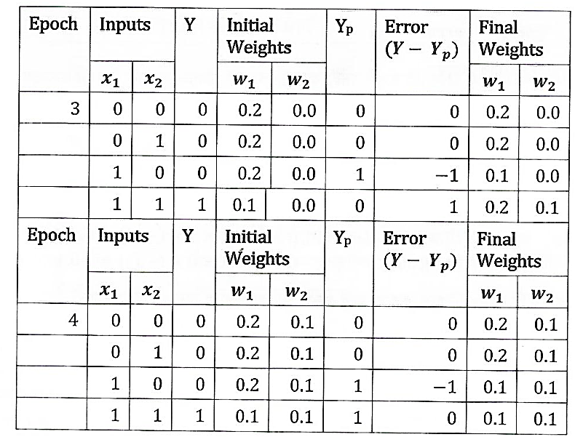

Slide 5
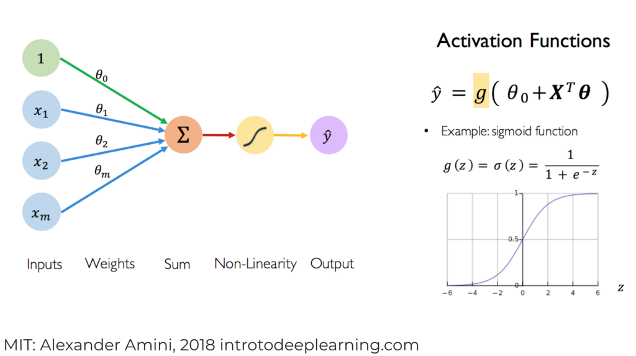
Neuron/Perceptron

Slide 6
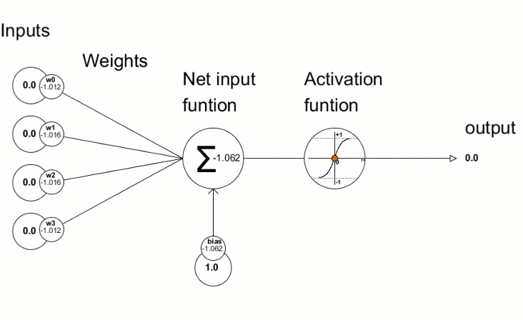

Slide 7
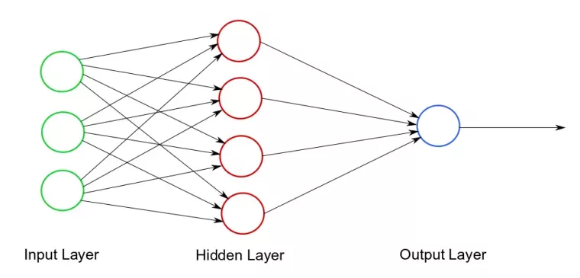
Neural Network

Slide 8

Neural Network

Slide 9
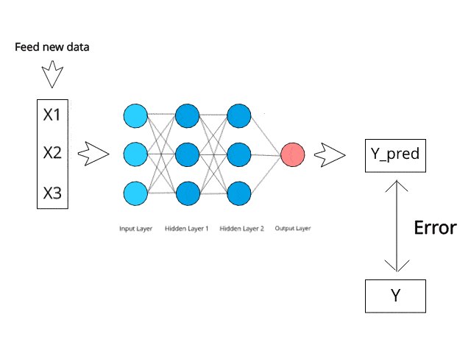
Neural Network

Slide 10
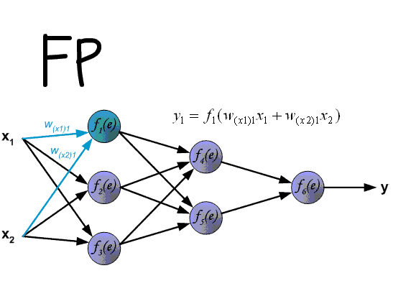
NN with Backpropagation

Slide 11
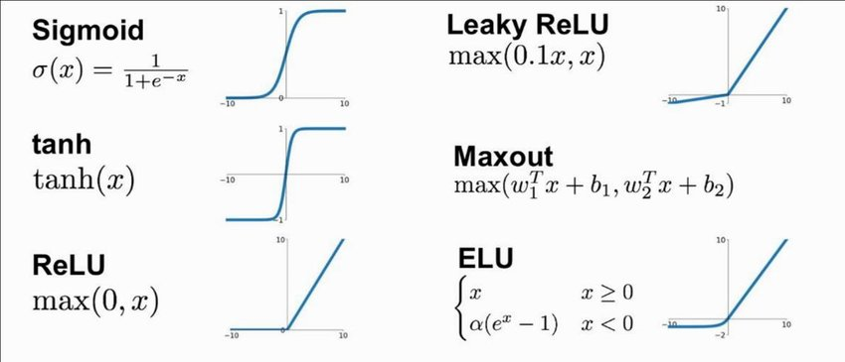
Activation Function

Slide 12
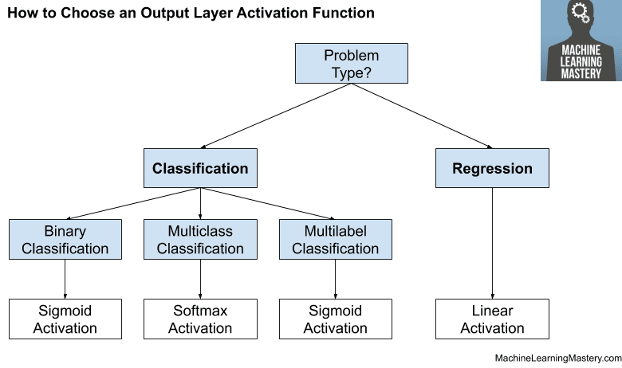
Activation Function
Multiclass: The output is a single class label.
Multilabel: The output is a binary vector indicating the presence or absence of each label.

Slide 13
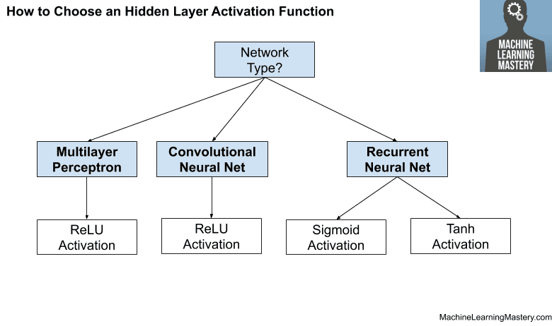
Activation Function

Slide 14
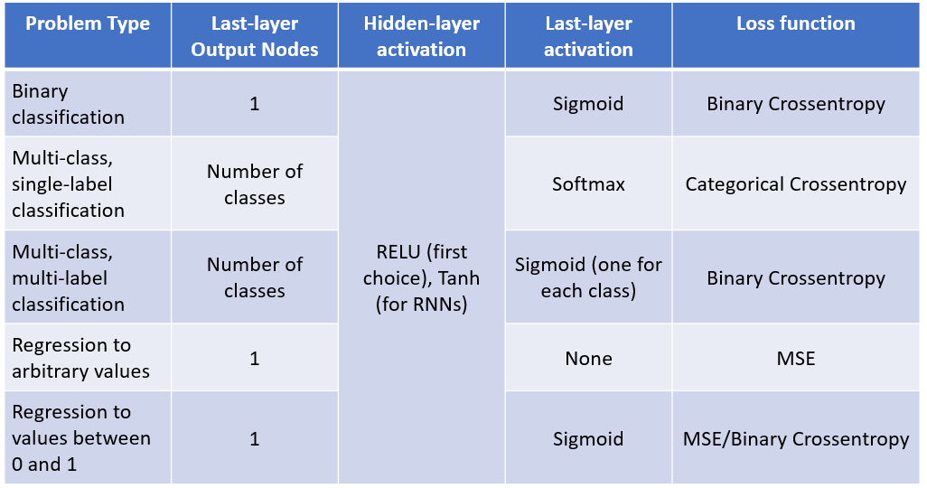
Loss Function

Slide 15
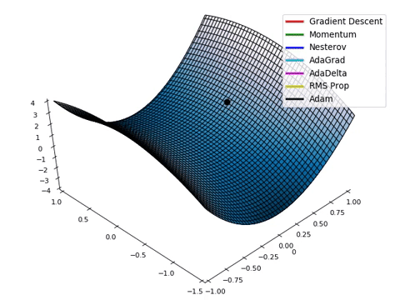
Optimizers
In the context of training a neural network, you typically need to specify a loss function that the optimizer will minimize.

Slide 16
Input X
Weight
Layer
(Data Transformation)
Weight
Layer
(Data Transformation)
Actual Target
Y
Weight
Update
Prediction, Y’
Optimizer
Loss Function
Loss Score
Fig. Loss score adjusting weights in the feedback network

Slide 17
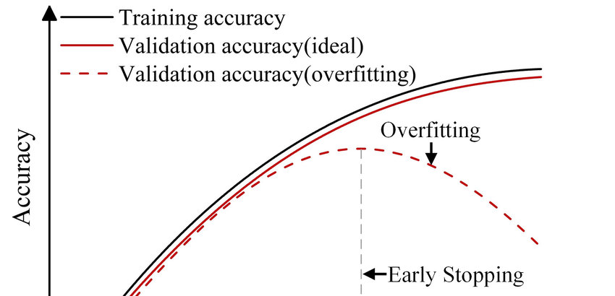
Overfitting & Underfitting

Slide 18
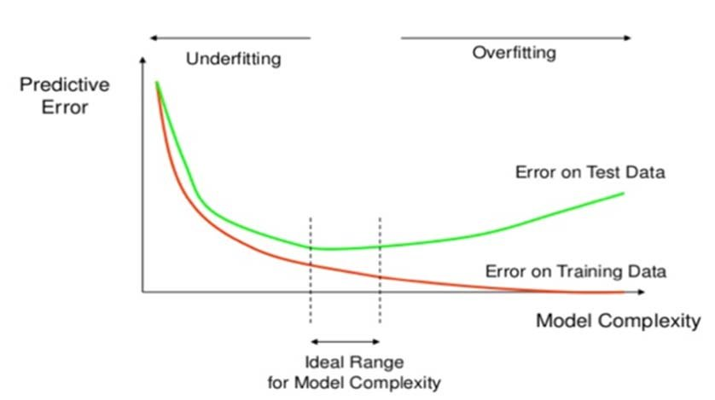
Overfitting & Underfitting

Slide 19


